Slide 1


<Name>
<Date>

Slide 2

Outline
Executive Summary
Introduction
Methodology
Results
Conclusion
Appendix

Slide 3
Executive Summary
Methodologies
Data Collection
Data Wrangling
Exploratory Data Analysis
Model Building
Interactive visualization

Slide 4
Executive Summary
Results
Model Performance
Key Insights
Interactive Visualizations:

Slide 5
Introduction
Project Background and Context:
Commercial Space Age: The industry is evolving, with companies like Virgin Galactic, Rocket Lab, and Blue Origin making space travel more accessible.
SpaceX's Leadership: SpaceX has set a benchmark with its achievements, including cost-effective launches and reusable rocket technology, specifically the Falcon 9.
Problems to Find Answers:
Launch Cost Determination: How can we accurately determine the price of each launch for the competing startup, Space Y?
First Stage Landing Prediction: What factors influence whether the Falcon 9's first stage will land successfully, and how can we predict this using machine learning?
Data Utilization: How can we effectively gather and analyze public data related to SpaceX to inform our predictions and strategies?

Slide 6

Section 1

Slide 7
Methodology
Executive Summary
Data Collection :
SpaceX API (GET Requests) and Web Scraping (BeautifulSoup)
Data Wrangling :
Data cleaning, missing values handling, feature engineering (launch sites, payload types)
Exploratory Data Analysis:
SQL Analysis and Visualization
Model Building:
Classification Model (Decision Trees, Random Forest)
Evaluation ( Accuracy, precision, recall, F1-score )
Interactive visualization
Folium and Plotly Dash

Slide 8
Data Collection
Identify Data Sources
Data was collected by a get request to the SpaceX API
I Retrieved data for SpaceX launches, including launch success or failure.
Web Scraping with BeautifulSoup
To extract additional information from SpaceX’s official website or other relevant sources
Then Store Data in CSV Format for processing
Simple and easy to work with for tabular data.
Compatible with most data analysis libraries like pandas in Python.
Easily exportable for sharing and further analysis.
Collect Data from SpaceX API (GET)
Web Scraping
(BeautifulSoup)
Store Data
In CSV

Slide 9
Data Collection – SpaceX API
Objective: Gather data related to SpaceX launches, including launch success, failure, dates, and other important metrics.
https://github.com/yhakam/IBM-Final-Project/blob/main/jupyter-labs-spacex-data-collection-api.ipynb
Collect Data from SpaceX API (GET)
Filter The dataFrame
(only include Falcon9 launches)
Replace missing values in PayLoad Mass by it’s mean

Slide 10
Data Collection - Scraping
Objectives:
Extract specific details about SpaceX launches
Websites such as SpaceX’s official site or third-party sources (e.g., mission updates, launches, landing sites).
Sending HTTP Requests:
Use requests library to send a GET request to a website.
Fetch the HTML content of the page to be parsed.
Parse HTML with BeautifulSoup:
Use BeautifulSoup to parse the HTML content.
Navigate through the parsed HTML tree to find specific data points (e.g., launch success, mission details, etc.).
Data Extraction:
Extract specific elements such as tables, launch dates, success/failure, etc.
Filter the required data using BeautifulSoup’s methods like .find(), .find_all(), and .text.
Store Data:
Store the scraped data in a structured format like CSV or Excel for further analysis.
Objectives
(start web scraping)
Send GET Request to website
Parse HTML
(BeautifulSoup)
Extract Data
Store Data in CSV
https://github.com/yhakam/IBM-Final-Project/blob/main/jupyter-labs-webscraping.ipynb

Slide 11
Data Wrangling
Data wrangling refers to cleaning and transforming raw data into a usable format for analysis. This process typically includes handling missing values, converting data types, and feature engineering.
Import Data: Loaded CSV file using pandas.read_csv().
Missing Data: Handled using dropna() or fillna().
Feature Engineering: Created Season and extracted date components.
Encoding: Converted categorical variables to numerical (e.g., success = 1, failure = 0).
Outliers: Removed extreme values in numerical columns.
Normalization: Scaled numerical features using Min-Max.
Final Prep: Selected relevant features for modeling.
https://github.com/yhakam/IBM-Final-Project/blob/main/jupyter-labs-webscraping.ipynb

Slide 12
EDA with Data Visualization
Bar Chart (Launch Success vs Orbit Type):
Purpose: To visualize the success rate based on the orbit type.
Why: Helps understand the Orbit types their success rate.
Catplot
Purpose: To explore how the payload mass affects the flight number and the success (class) of the landing.
Why: This plot helps identify if there's a relationship between the payload mass and the success rate of the mission, as well as how the success varies across different flight numbers. This can offer insights into whether certain payload masses or certain flight numbers are linked to higher chances of success or failure.
Scatter Plot (Flight Number/Payload Mass vs Launch Site):
Purpose: To visualize the relationship between flight number/payload mass and Launching Sites
Why: Helps understand how payload mass and flight number depends on the Launching site, which can influence predictions on landing outcomes.
Line Plot (Success Rate Throughout the Year):
Purpose: To track how the success rate of SpaceX landings has changed over time throughout the year.
Why: This plot helps visualize trends and patterns in the success rate, showing whether there has been an improvement or fluctuation in the success of landings as time progresses. It can help identify seasonal trends or operational changes that might have impacted the mission success rates
https://github.com/yhakam/IBM-Final-Project/blob/main/edadataviz.ipynb

Slide 13
EDA with SQL
Create Table: Defined SPACEXTBL with mission details.
Select Launch Sites: Queried unique Launch_Site. (DISTINCT)
Total Payload for NASA (CRS): Summed Payload_Mass__KG_ for NASA. (SUM)
First Successful Landing: Retrieved the earliest successful landing date.
Conditional Queries (Where, Like)
https://github.com/yhakam/IBM-Final-Project/blob/main/jupyter-labs-eda-sql-coursera_sqllite.ipynb

Slide 14
Build an Interactive Map with Folium
Markers
What: Placed at each launch site’s latitude/longitude.
Why: To pinpoint the exact location of each launch site and provide popups with site-specific details.
Circles
What: Drawn around launch site markers with a defined radius.
Why: To visually emphasize the site’s area of influence or highlight its significance.
Lines (Polylines)
What: (If included) Connect multiple launch sites.
Why: To illustrate spatial relationships or potential flight paths between sites.
https://github.com/yhakam/IBM-Final-Project/blob/main/lab_jupyter_launch_site_location.ipynb

Slide 15
Build a Dashboard with Plotly Dash
Pie Chart (Launch Success Distribution)
What: Displays overall success count for all sites or success vs. failure for a specific site.
Why: Quickly shows the proportion of successful vs. failed launches.
Range Slider (Payload Mass Filter)
What: Selects a range for payload mass (in kg).
Why: Filters data to analyze how payload mass influences launch success.
Scatter Plot (Payload vs. Launch Success)
What: Plots payload mass against launch outcome, with points colored by booster version.
Why: Visualizes correlation between payload and success, highlighting performance differences across booster versions.
Interactive Callbacks
What: Update the pie and scatter charts based on dropdown and slider inputs.
Why: Enhances user engagement by providing real-time, interactive data exploration.
https://github.com/yhakam/IBM-Final-Project/blob/main/spacex_dash_app.py

Slide 16
Predictive Analysis (Classification)
Data Preparation:
Split dataset into training and test sets.
Selected relevant features for prediction.
Model Building:
Built multiple classification models (e.g., Logistic Regression, Decision Tree, SVM, KNN).
Model Evaluation:
Employed cross-validation and calculated metrics (accuracy, precision, recall, F1-score).
Used confusion matrices for detailed error analysis.
Model Improvement:
Applied GridSearchCV for hyperparameter tuning.
Compared cross-validated scores to determine the best model.
Best Model Selection:
Chose the model with the highest mean cross-validation score and balanced performance metrics. (Linear Regression)
https://github.com/yhakam/IBM-Final-Project/blob/main/SpaceX_Machine%20Learning%20Prediction_Part_5.ipynb

Slide 17
Results
Exploratory data analysis results :
Launch Outcomes & Trends:
Visualized success/failure distributions across launch sites : KSC LC-39A represents 41,7% of the total Success launches, with a 76,9% success rate
Identified correlations between payload mass, Booster Version, and landing success. FT is the version with the highest success rate
Temporal Analysis:
Detected seasonal trends in landing success via line plots. Success rate is growing since 2013
Feature Relationships:
Catplot (Flight Number, Payload Mass, and Class):
Pattern: Successes (class = 1) tend to cluster at certain flight numbers and lower payload mass ranges.
Insight: Lower payload masses (typically under 6000 kg) and early flight numbers show higher success rates, suggesting an operational “sweet spot” where performance is optimal.
Scatter Plot (Payload Mass vs. Landing Success):
Pattern: A negative correlation is evident—launches with lower payload mass are more likely to be successful.
Insight: There’s a distinct clustering where many successful landings occur at lower payload masses, while higher payloads show more variability in outcomes. Additionally, grouping by booster version highlights that some versions consistently perform better across payload ranges. FT version especially
Bar Plot (Orbit types, Flight number and Success Rates):
Pattern: Certain Orbit type have way higher success Rates : GEO, HEO, SSO Because of their high flight numbers

Slide 18
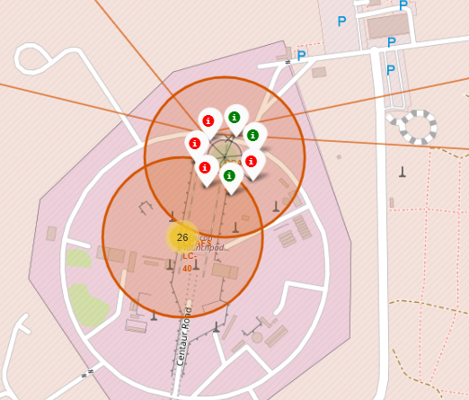
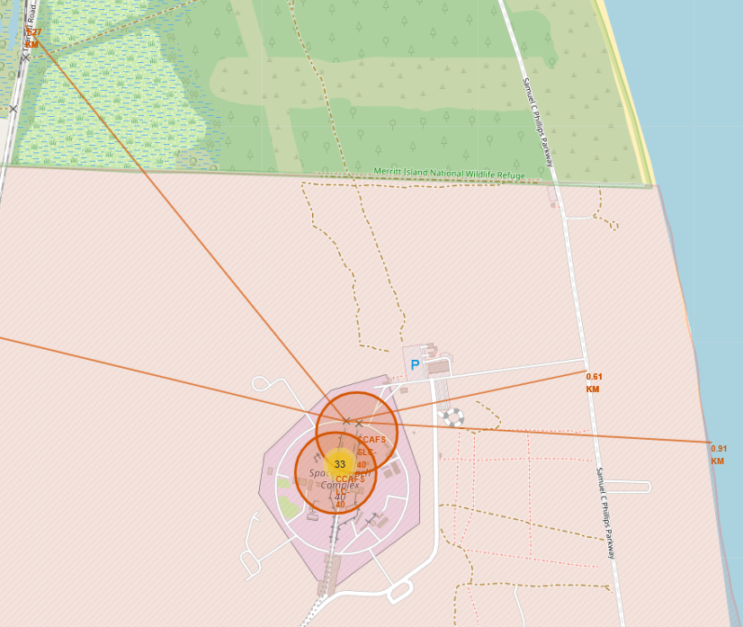
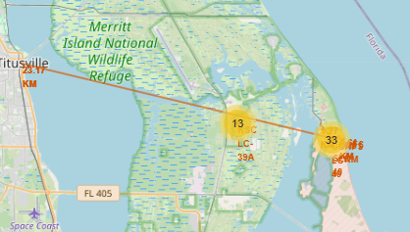
Results
(1)
Folium map
Markers for Launch Sites:
Placed markers at each launch site's latitude and longitude. (1)
Spatial Distribution:
Reveals clustering of launch sites (1).
Highlights geographical patterns that may influence launch outcomes: Launching sites are near Highway and railway, but far from cities. (2) (3)
Interactive Elements:
Enables users to zoom and pan for detailed local insights.
Provides a visual context for operational regions.
(2)
(3)

Slide 19
Results
(1)
(2)
(3)

Slide 20

Section 2

Slide 21
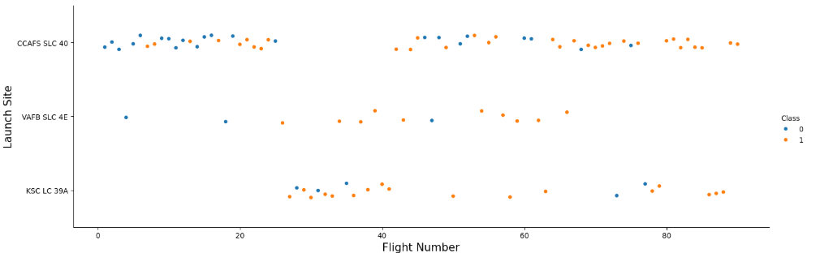
Flight Number vs. Launch Site
We can see in this catplot that CCAFSSLC40 has the highest number of Flights and his success is pretty much balanced, VAFB SLC 4E has fewer Flights but he still has more success than failure, we can explain that because maybe they invest more in each flights, so they have less in terms of numbers but they succeed way more, and Finaly KSC LC 39A has a moderate number of Flights, but he has the most success out of them all

Slide 22
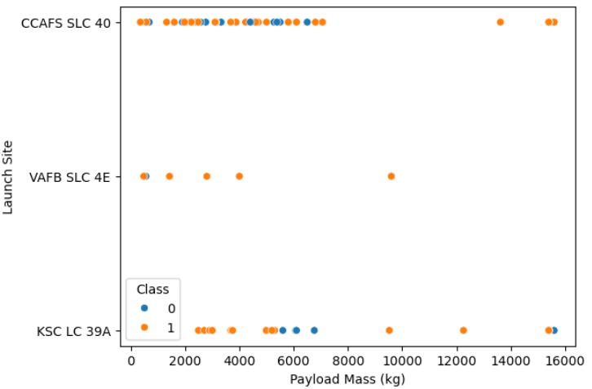
Payload vs. Launch Site
Here we see that The Majority of success comes from Payload Mass between 0 and 5000KG

Slide 23
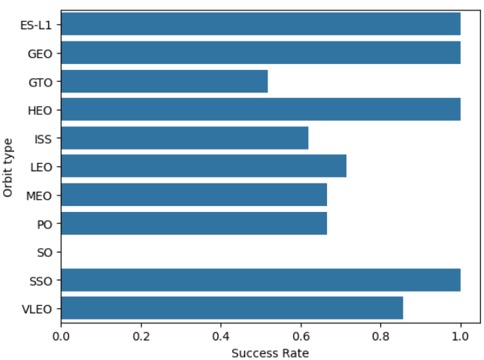
Success Rate vs. Orbit Type
This Bar Chart Shows us That the orbit Types with the highest success rate are GEO, HEO and SSO, ES-L1 has a very low number of Flight so this is not very representative

Slide 24
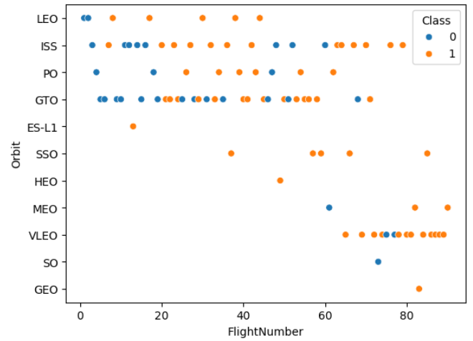
Flight Number vs. Orbit Type
This Scatterplot shows us that for some orbit Types, the more SpaceX make flights the more the success rate increase, this is especially the case with SSO, VLEO, ISS and LEO we recognize a pattern, than the majority of Flight that exceed 40 are successes

Slide 25
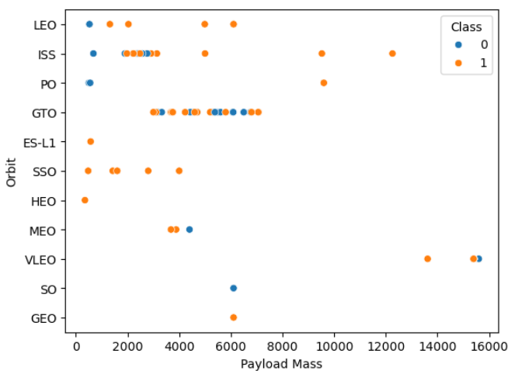
Payload vs. Orbit Type
We can see in this Scatter Plot that the Majority of Orbit Type doesn’t have record after a Payload Mass of 6000KG, we can note that the trend is the contrary for VLEO, we don’t see any record before 12 000KG

Slide 26
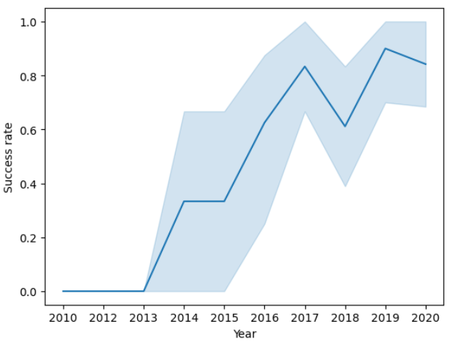
Launch Success Yearly Trend
This Show us The Success rate throughout the year, we can clearly see that since 2013 we have a big increase in success rate until 2020

Slide 27
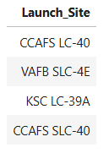
All Launch Site Names
This shows us all the Launch Sites

Slide 28
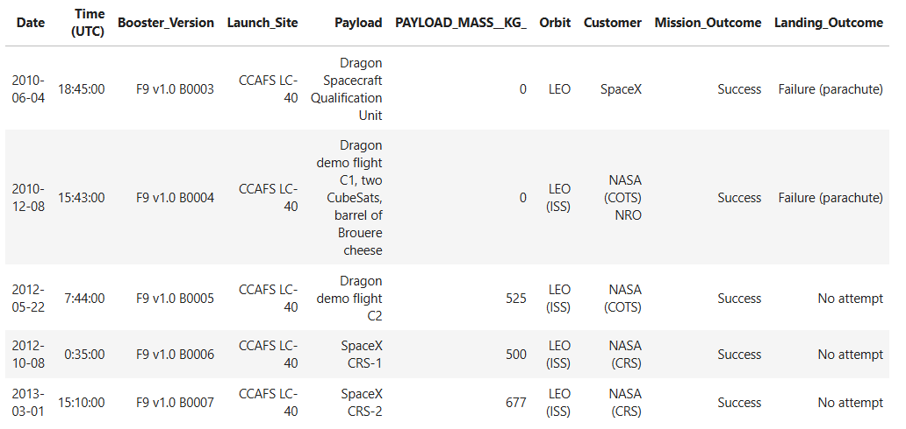
Launch Site Names Begin with 'CCA'
This Shows us the Five First record from Launch Site that begins by “CCA”

Slide 29
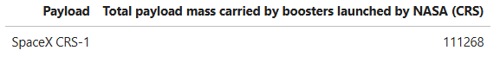
Total Payload Mass
This Shows us The total Payload mass Carried by boosters launched by Nasa (CRS)

Slide 30
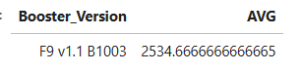
Average Payload Mass by F9 v1.1
This shows us the Average Payload mass in KG of the Booster Version F9 v1,1

Slide 31
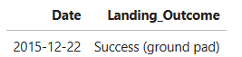
First Successful Ground Landing Date
This shows us the First successful landing in ground pad

Slide 32
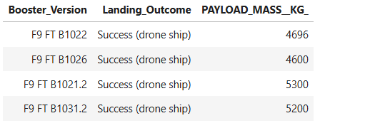
Successful Drone Ship Landing with Payload between 4000 and 6000
This query shows us the Booster version wich have success in drone ship and have a payload mass between 4000 and 6000 KG

Slide 33
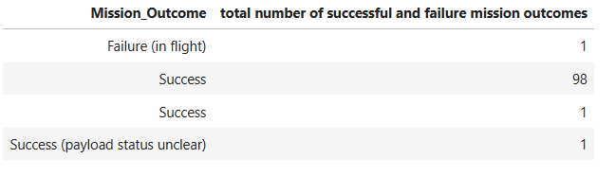
Total Number of Successful and Failure Mission Outcomes
We had 100 mission successs and only one Failure, That shows that the majority of Landing Failure are still considered a mission Success because some of the landing failure are predetermined

Slide 34
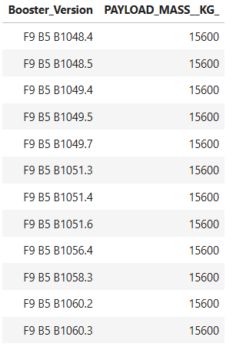
Boosters Carried Maximum Payload
This is the list of All Booster Version that reached the Max Payload Mass (15600)

Slide 35
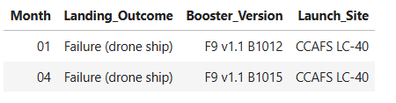
2015 Launch Records
In 2015 we only Had two drone ship Failure in January and April

Slide 36
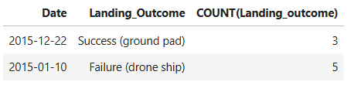
Rank Landing Outcomes Between 2010-06-04 and 2017-03-20
Here we can see that in 2015 SpaceX had 5 Failure on Drone Ship and 3 Success on ground pad

Slide 37

Section 3

Slide 38
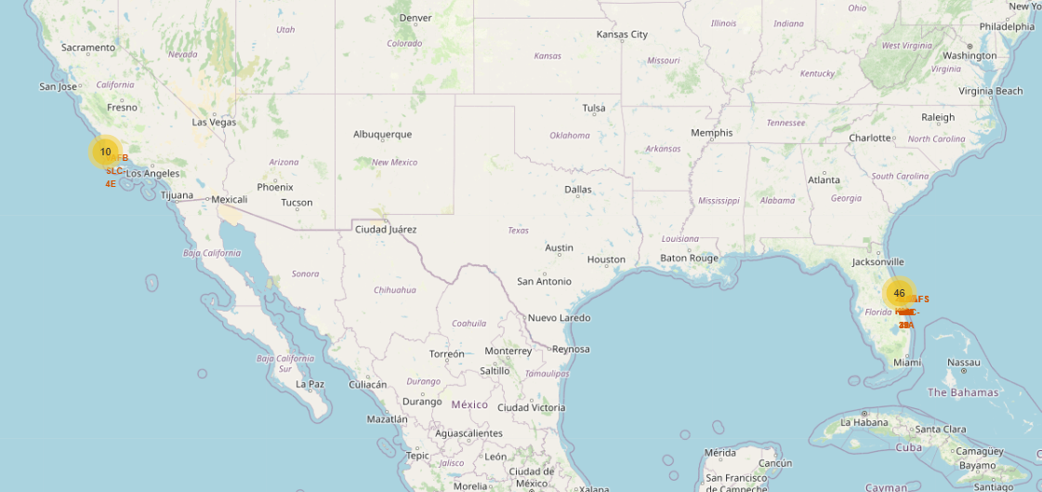
Launching sites Clusters in the Global Map
We can see that launching sites are located in the east and west coast of America, because they are usually plain areas ideal to launch spaceships

Slide 39
Markers of Succesful landings and Failed ones
In green we see the successful landings, and in red we see the failed ones, we can see that they are all concentrated at around the same place, that’s why their success rates are pretty much the same

Slide 40
Distance Between Launching sites and highway,railway and cities
We can see that the launching sites are near highway and railways but far from cities

Slide 41

Section 4

Slide 42
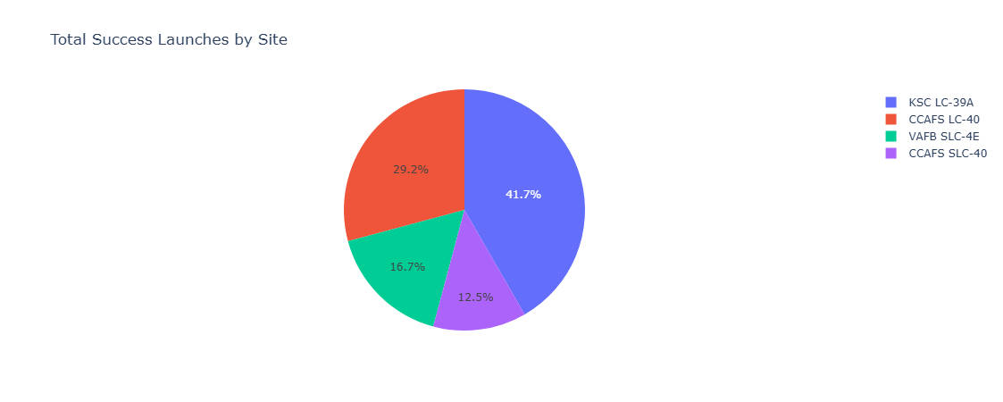
Total Success Launches by Site
We can see that KSC LC-39A has the highest number of success landings

Slide 43
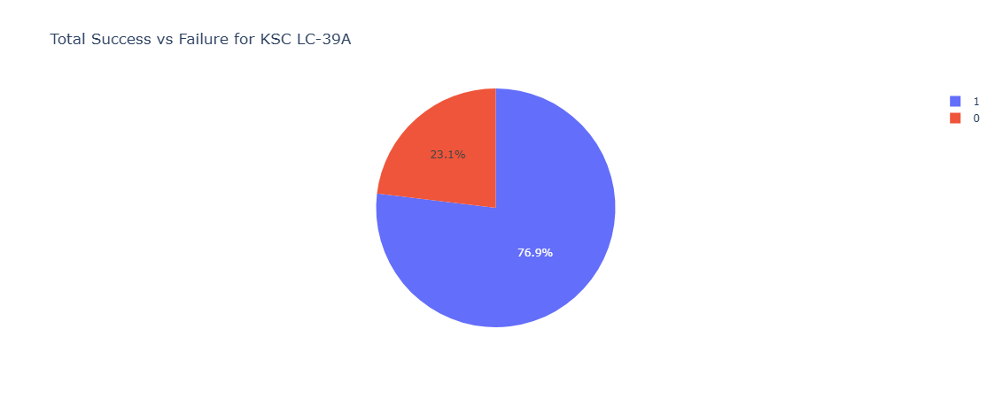
Total Success vs Failure for KSC LC-39A
KSC LC-39A also has the highest success rate

Slide 44
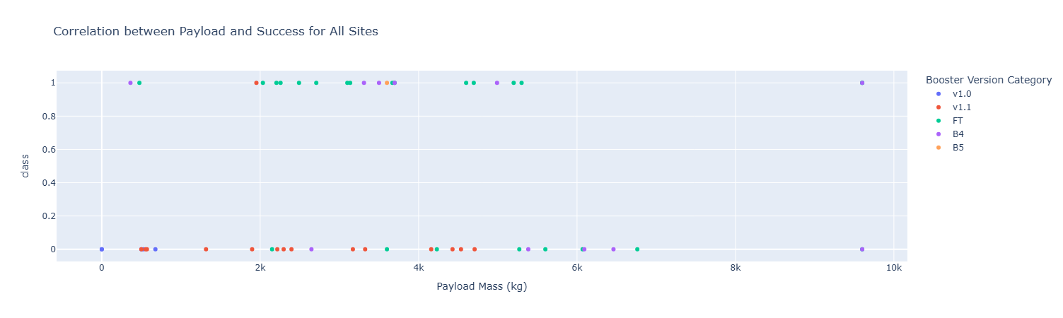
Correlation Between Payload Mass and Success rate for All Sites
We can see that the Booster version with the highest success landings is FT
And the highest number of success landings are found when Payload Mass is between 2000 and 6000 KG

Slide 45
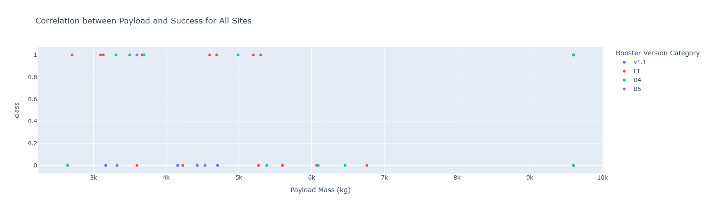
Correlation Between Payload Mass and Success rate for All Sites
Even if we change the payload Mass FT is still the best version in terms of success rate

Slide 46

Section 5

Slide 47
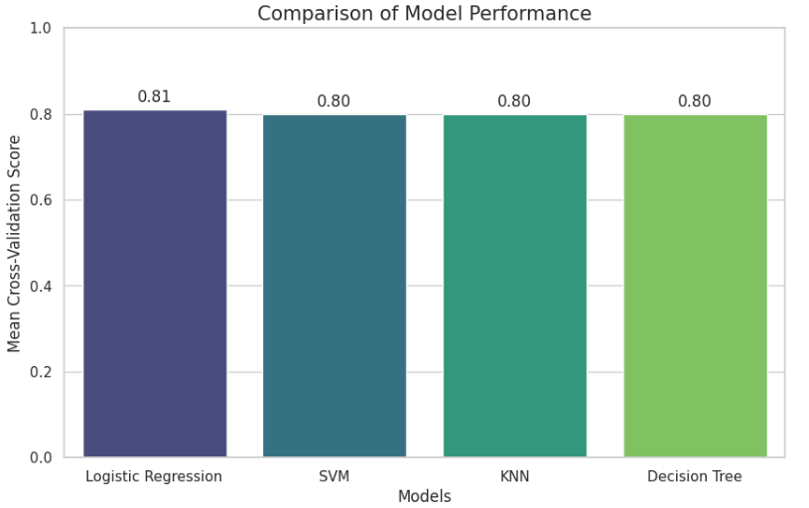
Classification Accuracy
I did a Cross validation Score test, because all the confusion matrix was similar, so base on the mean Cross-Validation Score, Linear Regression has a better accuracy than the other models

Slide 48
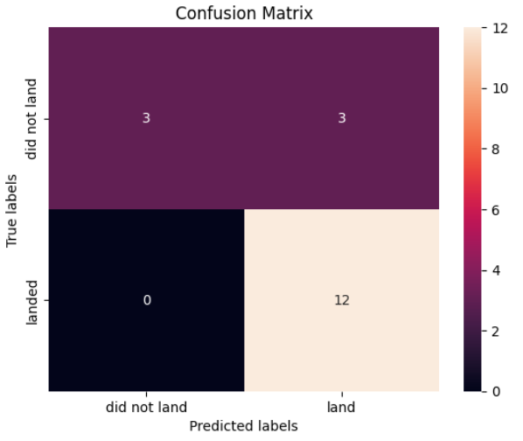
Confusion Matrix
Here we have 12True Positive, 3 False Positive, and 3 True Negative, wich gives us an accuracy of 83,33%, the model predict that the landing will be successful with an accuracy of 83,33%

Slide 49
Conclusions
To conclude, All our researches showed that SpaceX despite having a lot of Landing Failure has 99% of mission success, that shows that thoses Landing Failures was wanted, and by predicting the outcome with the data at our disposition, we saw that the model predicted 12 times out of 18 that the landing will be successfully, With all those Data we can now assume that indeed the Falcon 9 will cost 62 Million dollars, with an accuracy of 83,33%

Slide 50


